Slide 1
Professor Recommendation Service
LastLap
김현진 송민석 장민석 조재희
2024.09.20
Notes:
We are planning to implement an AI-based website to assist students when contacting labs.

Slide 2
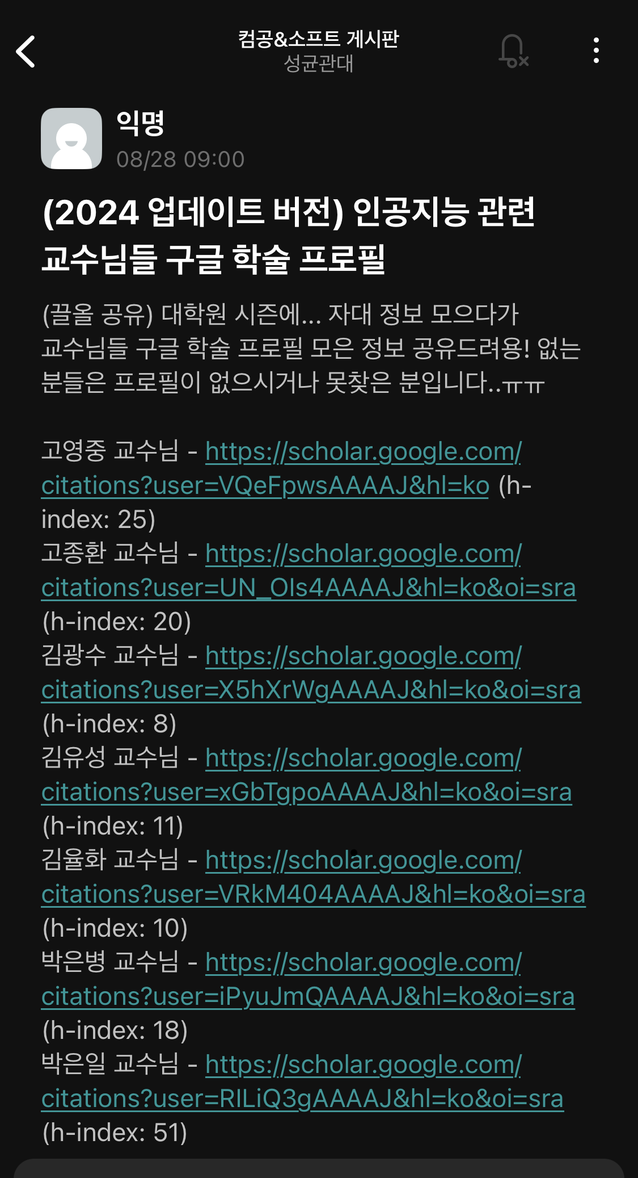
1. Motivation
The problem is..
There is no well-organized website
about professors’ profiles.
Students are suffering from searching labs!
24-Fall Capstone Design Project
Notes:
Our focus is on addressing the challenges students typically face when searching for lab and professor information, particularly for Undergraduate Research Programs (URP) or graduate school applications.
Finding information about professors and their labs is crucial, but there is no well-organized website that compiles this information effectively. Students often don't know which professors are working in their areas of interest, and searching for them individually can be time-consuming and may not always yield accurate information.

Slide 3


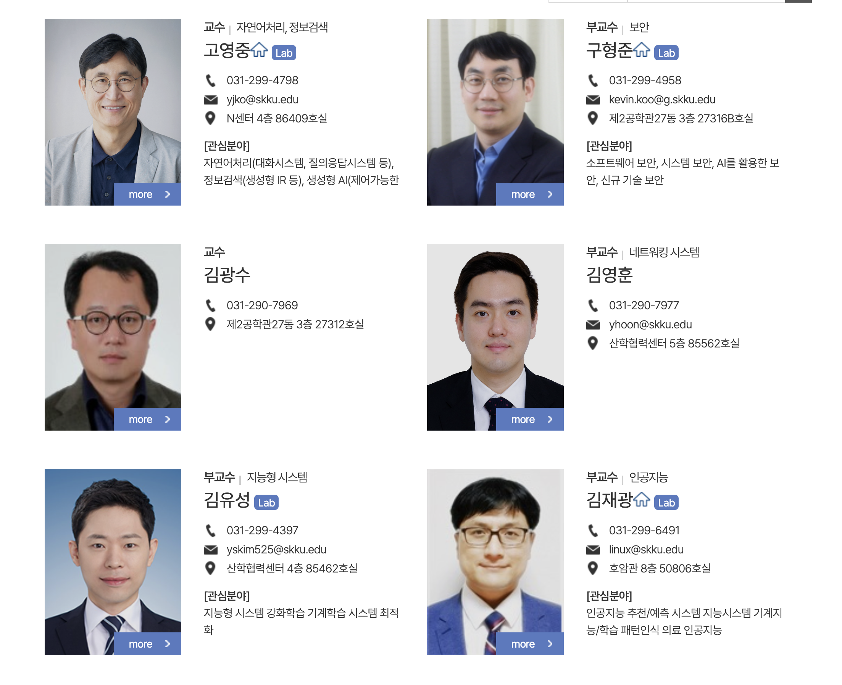
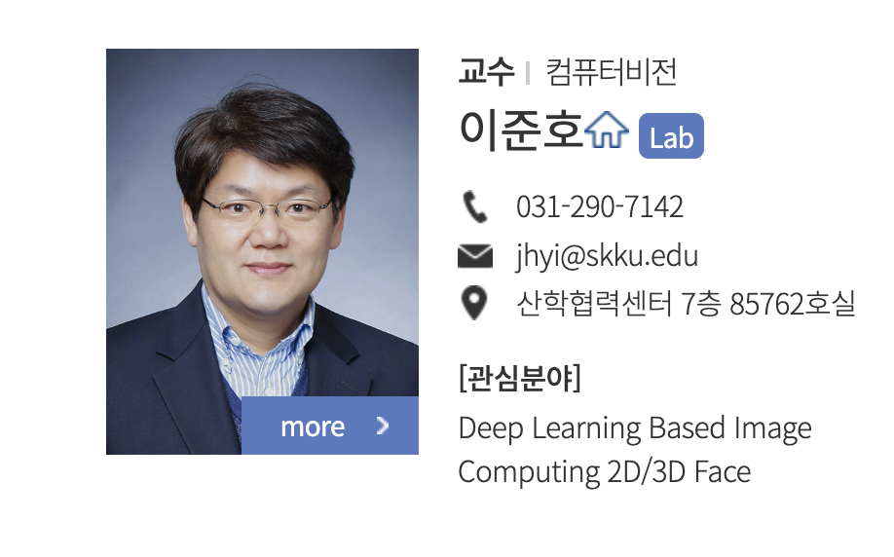

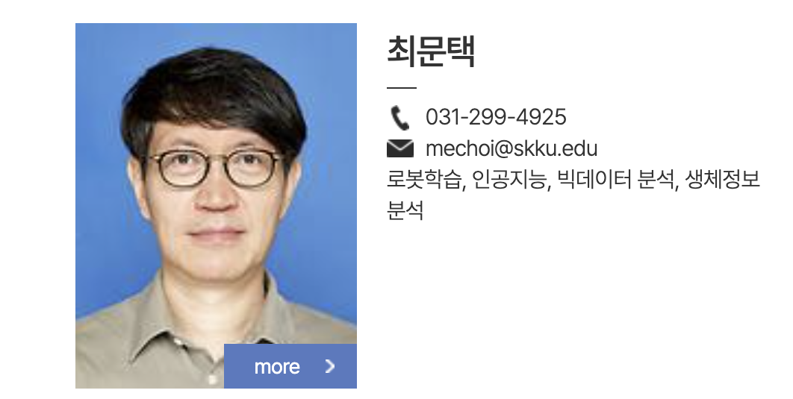
1. Motivation
For example..
I’m trying to find AI professor, so I search SW department professor,,,
I couldn’t get to know details only with areas of interest and someone has nothing
Some professors are not in SW but in others.
.
+α
!!!! nothing
24-Fall Capstone Design Project
Notes:
For instance, if a student is searching for professors related to AI, they might begin with the software department. However, the first challenge arises when it’s hard to determine exactly what kind of research is conducted in each lab just from the professors' listed interests. Students must manually visit each professor's website to gather detailed information. Additionally, there may be relevant professors in other departments, such as mechanical engineering or electrical engineering, which students might not initially consider. In fact, in our school's community, there have been attempts to compile lists of professors in specific departments, but these are often incomplete or inaccurate.

Slide 4
2. Expected Outcomes
“
“
A Professor Recommendation Service
Based on Natural Language Processing Models
Expected Outcomes
Reduced effort for professors in student recruitment
Broader access to professors conducting research in areas of interest beyond one's own department
Ability to explore detailed subfields beyond the major field of study
24-Fall Capstone Design Project
Notes:
Therefore, we aimed to develop a recommendation service based on a natural language processing model. Through this service, professors can easily recruit students with similar interests, and students can easily learn about and apply for research topics of professors, not only within their own department but also in other departments. Additionally, students will be able to understand not only broad research areas but also specific research topics.

Slide 5
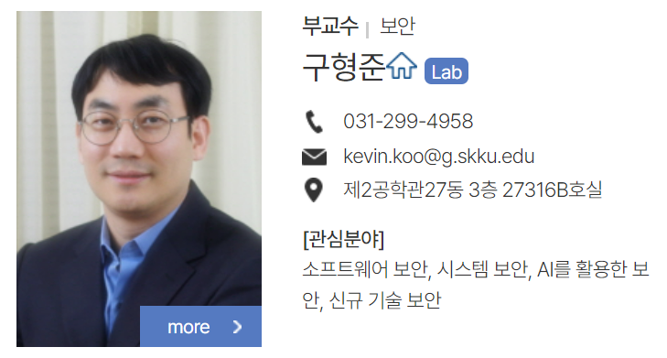


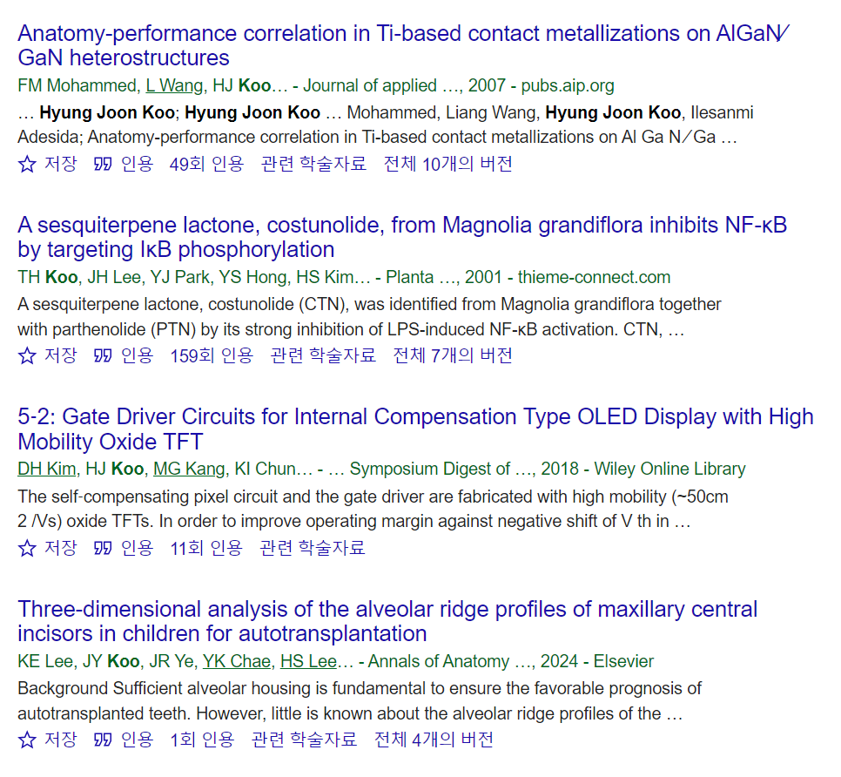

3. Functions and expected related technologies
Functions
Security
Recommended Results
Expected related technologies
Text Embedding (BERT, Word2Vec)
Web Crawling (BeautifulSoup)
Recommendation System (Content Based Filtering, Similarity Search)
24-Fall Capstone Design Project
Notes:
The main function of the service is to analyze professors' papers using text embedding by inputting keywords related to research topics, and based on the results, it recommends the most suitable advisor. In the process of implementing these features, it is expected that technologies such as Text Embedding (BERT, Word2Vec), Web Crawling (BeautifulSoup), and Recommendation Systems (Content-Based Filtering, Similarity Search) will be utilized.

Slide 6


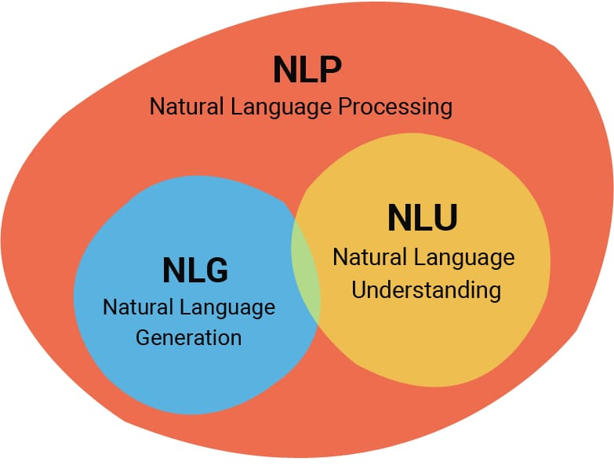
4. Role Allocation
Web design and frontend development
Backend and database design
Crawling and AI modeling design
24-Fall Capstone Design Project
Notes:
We divided this project into three major areas: web design and front end development, back-end development and database design, and paper crawling and AI model design. Through this division of roles, we plan to carry out the project.

